Slide 1

Bachelor’s Thesis Computer Science Probabilistic Short-term Wind Power Forecasting
Johannes Gaus
18.07.2022
Notes:
Slide 1
Wrote bachelor thesis the last 4 to 5 month
Sadly, worked always on Monday so no team meetings for mee
But today I will present my bachelors thesis and what I have done
Bachelor’s Thesis Computer Science Probabilistic Short-term Wind Power Forecasting

Slide 2
Contents
01 Introduction
02 Research Question
03 Approach
04 Results
05 conclusion
Notes:
Slide 2
So what am I going to talk about
Contents
- 01 Introduction -> little bit of Motivation
- 02 Research Question -> main goal of the thesis, what is about
- 03 Approach -> theoretical approach and practical approach, so like the methods and the coding or model building
- 04 Results -> my results
- 05 Conclusion -> conclusion and discussion

Slide 3
01 Introduction
Why bother with wind power forecasting?
to plan and operate a wind power farm
big shift to renewable energy sources and cope with the shortage of traditional fossil energy and the environmental pollution
successful integration of large amounts of wind power into the electricity supply system
Notes:
Slide 3
- Introduction
Why bother with wind power forecasting at all?
-> to plan and operate a wind power farm you need to at least have a plan what wind power you can expect
-> Recent years big shift to renewable energy sources and
-> cope with the shortage of traditional fossil energy and the environmental pollution
-> consequently successful integration of large amounts of wind power into the electricity supply system

Slide 4
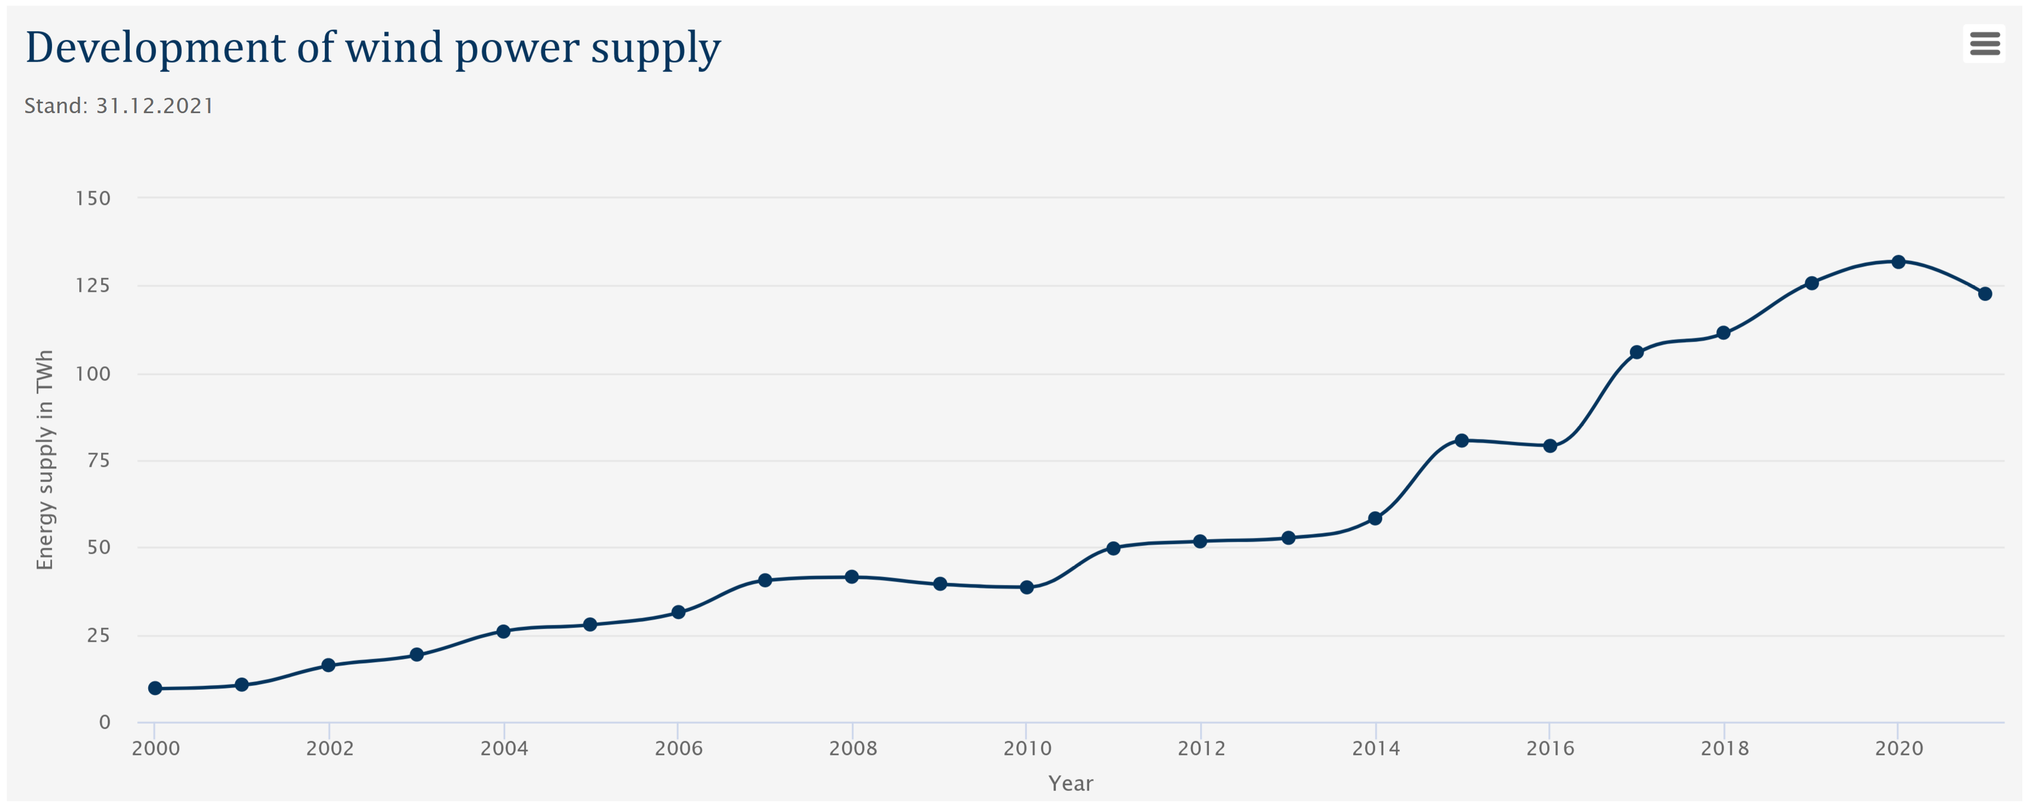
https://www.wind-energie.de/english/statistics/statistics-germany/
Notes:
Slide 4
-> In 2021 wind energy had the largest share in German electricity production, about 23 % and it is not going to get less.
-We can see here in this graph, year and Terawatt-hour from wind power, tendency to get even bigger

Slide 5

02 Research Question
Notes:
Slide 5
-> research question, what have i done the last 4 months?

Slide 6
Research Question
How to make a wind power forecasting model?
What is a good approach?
Multiple Linear Regression
Support Vector Regression
Which model works better with the dataset?
Notes:
Slide 6
-> How to make a wind power forecasting model?
What is a good approach? In my thesis I am looking at
- Multiple Linear Regression
Support Vector Regression
But I briefly talk about what else there is
Which model works better with the dataset? Can we use these models to make a windpower forecast?
- I build 2 diff models and used some evaluation scores and evaluated and compared the different models

Slide 7
Approach Breakdown
Tian, Zhongda (2021). “A state-of-the-art review on wind power deterministic prediction”.
physical, statistical, and hybrid models
further divide statistical models into three categories:
time series approaches
ensemble prediction approaches
artificial intelligence approaches
artificial intelligence model with a supervised machine learning approach
Multiple Linear Regression
Support Vector Regression
Notes:
Slide 7
I used this breakdown to kind of categorise my work a little bit
Tian et al breakdown of approaches a review from last year
physical -> use physical variables concerning the wind farm for physical or numerical
weather prediction models
statistical -> use time-series data a wind farm generates
hybrid models -> combination of NWP and statistical methods
further divide statistical models into three categories:
time series approaches -> ARMA (autoregressive-moving-average) or ARIMA
ensemble prediction approaches -> range of possible future states and often use multiple models to make a prediction
artificial intelligence approaches -> supervised and unsupervised machine learning approaches
artificial intelligence model with a supervised machine learning approach
-> Multiple Linear Regression
-> Support Vector Regression

Slide 8
Some literature
Tawn, R. and J. Browell (2022). “A review of very short-term wind and solar power forecasting”. In: Renewable and Sustainable Energy Reviews 153, doi: 10.1016/j.rser.2021.111758.
Tian, Zhongda (2021). “A state-of-the-art review on wind power deterministic prediction”. In: Wind Engineering 45.5 doi: 10. 1177/0309524X20941203.
Wang, Xiaochen, Peng Guo, and Xiaobin Huang (2011). “A Review of Wind Power Forecasting Models”. In: Energy Procedia 12, pp. 770–778. issn: 18766102. doi: 10.1016/j.egypro.2011.10.103.
Notes:
Slide 8
Some realted work, other papers and literature and reviews
Some recent revirews
Tawn et al (2022)
Tian et all (2021)
A little less recent
Wang et al (2011)
-> but generally a lot of papers and articles about the topic. therefore reviews work quite well for an overview for me

Slide 9

03 Approach
Notes:
Slide 9
-> approach
As said beforea supervised machine learning approach
-> Multiple Linear Regression
-> Support Vector Regression
- First I talk a little bit about the theory part and then what I did in practice

Slide 10
03 Theoretical Approach
What is Multiple Linear Regression
What is Support Vector Regression
What is an Evaluation Score
Notes:
Slide 10
- What is Multiple Linear Regression
- What is Support Vector Regression
- What is an Evaluation Score or what do I use to evaluate my models and compare them

Slide 11
Multiple Linear Regression
statistical technique that uses two or more independent variables to predict the outcome of a dependent variable
Ordinary Least Square approach
MLE approach
Notes:
Slide 11
- Mult Lin Reg approach, first thing you learn in a machine learning related lecture or book or anything
statistical technique that uses two or more independent variables to predict the outcome of a dependent variable
Kind of 2 methods to get a good models
- Linear least squares (LLS) or Ordinary Least Square is the least-squares approximation of linear functions to data to fit the regression line to the data
Least squares optimization is an approach to estimating the parameters of a model by seeking a set of parameters
that results in the smallest squared error between the predictions of the model (yhat) and the actual outputs (y), averaged over all examples in the dataset
- Maximum Likelihood estimation approach is a frequentist probabilistic framework
that seeks a set of parameters for the model that maximize a likelihood function

Slide 12
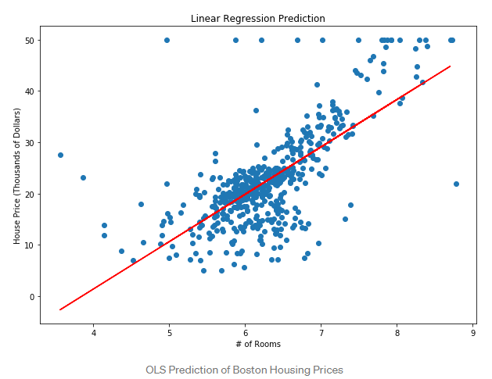
Figure 1 https://towardsdatascience.com/an-introduction-to-support-vector-regression-svr-a3ebc1672c2
Notes:
Slide 12
example for Lin Reg, classical example (Boston housing prices)
We see the curve for our Lin Reg. As we can see the data points we minimize the range between the curve and all the datapoints
we have the number of rooms and predict the housing price -> 8 rooms like 40.000 dollar
- Here is just one independent variable (rooms) to predict the housing price, but we can choose more thanone

Slide 13
Support Vector Regression
SVM ⇒ Classification
SVR for working with continuous Values instead of Classification
In simple linear regression, we try to minimize the error rate. In SVR, we try to fit the error within a certain threshold.
Notes:
Slide 13
- SVM Support Vector Machines are used for Classification
- SVR is kind of the regression approach for working with continuous Values instead of Classification
In simple linear regression, we try to minimize the error rate.
In SVR, we try to fit the error within a certain threshold. But more on that in the next slides

Slide 14
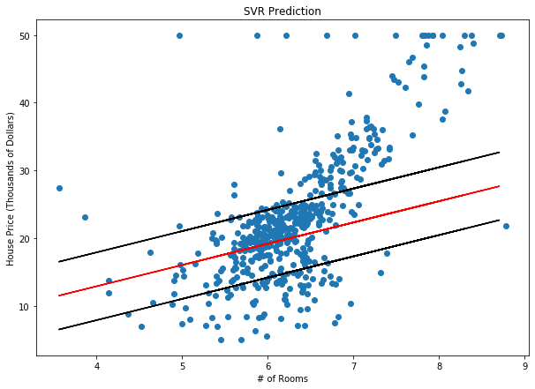
SVR
margin w+ε
hyperplane w
ε
margin w-ε
ξ
slack variable ξ
Figure 2 https://towardsdatascience.com/an-introduction-to-support-vector-regression-svr-a3ebc1672c2
Notes:
Slide 14
- Same dataset, Boston housing prices.
- w the hyperplane shows the regression line as before
- The hyperplane is the line used to predict the continuous output for the regression.
- we can see the ϵ-tube or margin with the borders w+ϵ and w-ϵ. We consider all the data points as long as our data
is inside this ϵ-tube.
- We can also assign some slack variables ξ to account for any points outside the ϵ-tubeWe define a penalty for points outside the tube
- And then we try to find the tube where most of the data is within with as little as possible slack variables
- here with the same independent and dependent variables as before, but we can also choose more than one
- Bu thats not all
- Until this point, our Support Vector Regression model only uses linear data.
- The cooler part is that we can make the model or more precise the data nonlinear by using the kernel trick

Slide 15
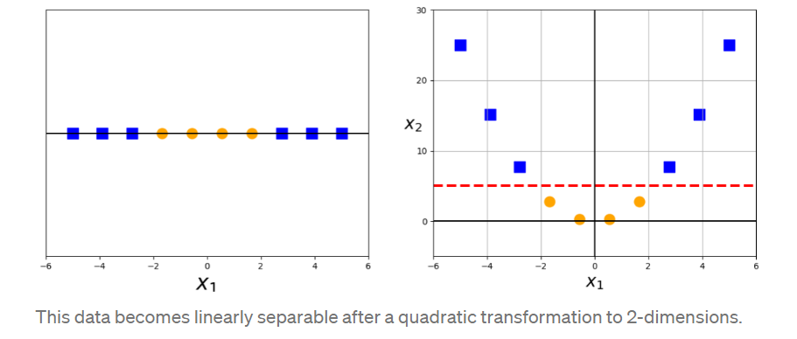
The kernel trick
- Smola, Alex J. and Bernhard Schölkopf (2004). “A tutorial on support vector regression”. In: Statistics and Computing 14.3, doi: 10.1023/B:STCO.0000035301.49549.88
Figure 3 https://towardsdatascience.com/the-kernel-trick-c98cdbcaeb3f
Notes:
Slide 15
We can map our data into some higher feature space using a kernel (which has to follow some math equation like mercers theorem to work)
A more concrete example here
and then apply the Standard Support Vector Regression algorithm.
- we can map the seen data in to x^2 into a new feature space of x^2.
Therefore we can map the data into a higher dimension using a kernel and then have many more opportunities to find
a better fit. Linear regression only looks at the linear possibilities.
- We do not have to calculate and map every single data point. We only have to calculate the dot product.
- for more magin and the math why this works-> Smola et all in "How Support Vector Regression works" does a very good job explaining all of this

Slide 16
Support Vector Regression
We can choose how tolerant we are of errors, through an acceptable error margin(ϵ) and by tuning our tolerance of falling outside that acceptable error rate
we can map linear data into a higher feature space to get a better regression line for the SVR algorithm
RBF Kernel
Linear Kernel
Poly Kernel
…
Notes:
Slide 16
- So to summarize
- We can choose how tolerant we are of errors, through the epsilon tube and by tuning our
tolerance of falling outside that acceptable error rate with our Xi variables
- we can map linear data into a higher feature space to get a better regression line for the SVR
- There are many different kernels like RBF Kernel Linear Kernel Poly Kernel and many more...

Slide 17
Evaluation Scores
MAE ⇒ mean absolute error
RMSE ⇒ root mean squared error
R2 ⇒ how well the data fit the regression model (the goodness of fit)
CRPS ⇒ comparison of the predicted cumulative density function (CDF) and the true cumulative density function
Shapley Values ⇒ attempt to explain why an ML model reports the outputs that it does on an input
Notes:
Slide 17
So okai now we can build these 2 models. But how do we evaluate and assess them?
We can use some evaluation scores, which are all very basic mostly
- MAE -> mean absolute error, measures the average magnitude of the errors in a set of forecasts, without considering their direction
- RMSE -> root mean squared error, RMSE is a measure of how spread out these residuals are.
In other words, it tells you how concentrated the data is around the line of best fit.
R2 score -> how well the data fit the regression model (the goodness of fit). Gets calculated with 1 minus the residual sumof square divided by Total Sum of Squares
CRPS -> comparison of the distribution of the predicted dataset with the real data from the test dataset.
Shapley Values -> attempt to explain why an ML model reports the outputs that it does on an input.
Calculate by computing a weighted average payoff gain that a player provides when included in all coalitions that exclude the player.
In the simplest ML setting, the players of this cooperative game are replaced by the features of the ML model and the payoff by the model output itself

Slide 18
03 Practical Approach
Cleaning the dataset
Feature selection
Multiple Linear Regression model Support Vector Regression model parameter and kernel selection
Notes:
Slide 18
- After this therotical talking we can finaly come to the practical approach and what I did
- Cleaning the dataset
- Feature selection
- Multiple Linear Regression model Support Vector Regression model parameter and kernel selection

Slide 19
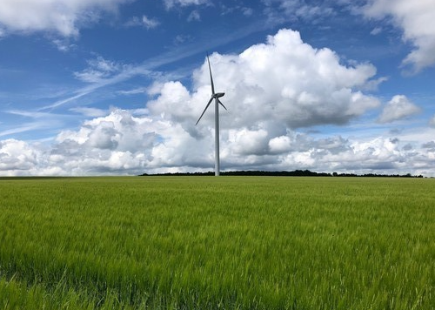
dataset
La haute borne windfarm in France
about 150 km west of Strasbourg
4 turbines
https://opendata-renewables.engie.com/explore/dataset/01c55756-5cd6-4f60-9f63-2d771bb25a1a/information
Figure 4 https://www.thewindpower.net/windfarm_en_3354_la-haute-borne.php
Notes:
Slide 19
- The data is from the La haute borne windfarm in France
- about 150 km to the left of Strasbourg
- 4 turbines
Data from 2016 until 2018
138 columns -> like 30-35 different possible features and 217,588 rows od data with a time stamp
- before we can use the dataset I had to clean the datasets and correct any meassurement errors or throw away any Nans

Slide 20
Feature Selection
tried some algorithms
tried some features by hand
evaluate the different features using
a Multiple Linear Regression model
MAE score, RMSE score, CRPS, and R2 score
Notes:
Slide 20
- feature selection
- I tried some Algorithm from sklearn
- recursive feature elimination algorithm
- select k-Best algorithm
- tried some features by hand
- evaluate the different features using Multiple Linear Regression model and taking the data into a 20:80 split so
80 % to train the individual models and 20 % to evaluate them.
- Used MAE score, RMSE score, CRPS, and R2 scores

Slide 21
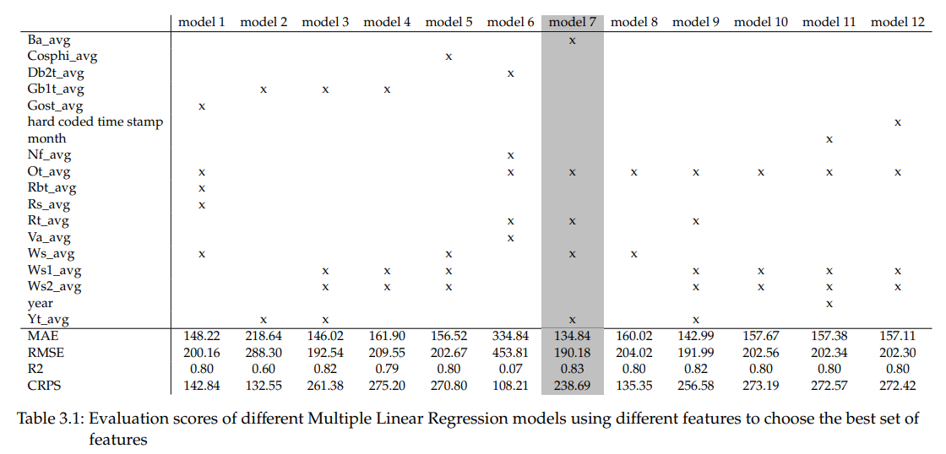
Feature Selection
Figure 5
Notes:
Slide 21
- Here we cans ee a selection of models or different combinations of features I have tried
- on the left side are all the features we used in the model
- in the top is the individual model and a cross if we it uses the feature
- at the bottom we can see the individual evaluation scores
-as you can see model 7 had the best evaluations cores
Ba -> pitch angle in degree
Cosphi -> is the phase angle between voltage and current
DBt -> generator bearing temperature (lager)
Gbt -> gearbox temperature
Gost -> Gearbox oil sump (Ölwanne) temperatur
NF-> grid frequency fluctuates around 50 Hz in a +/- 20 mHz wide corridor
Ot -> outdoor temp
Rbt -> Rotor bearing temperatur (lager)
Rs -> rotor speed
Rt -> hub temp, component that connects the blades to the main shaft
Va -> vane position, wind vane on the nacelle
Ws -> wind speed
Yt -> nacelle temperature

Slide 22
Feature Selection
- the pitch angle (BA)
the hub temperature (Rt)
the nacelle temperature (Yt)
the wind speed (Ws)
the outdoor temperature (Ot)
Figure 5
Notes:
Slide 22
the pitch angle (BA)
the hub temperature (Rt)
the nacelle temperature (Yt)
the wind speed (Ws)
the outdoor temperature (Ot)
- the pitch angle (BA) -> The pitch angle is the angle the blades of the wind turbine have.
- the hub temperature (Rt) -> Hub temperature describes the temperature of the hub.
The hub is the component that holds the blades and connects them to the main shaft.
- the nacelle temperature (Yt) -> The nacelle temperature tells the temperature of the nacelle, which is the
housing on top of the main shaft.
- the wind speed (Ws)
- the outdoor temperature (Ot)
The wind speed and the outdoor temperature are self-explanatory
-> Not really surprising,wind speed and temperature, ...

Slide 23
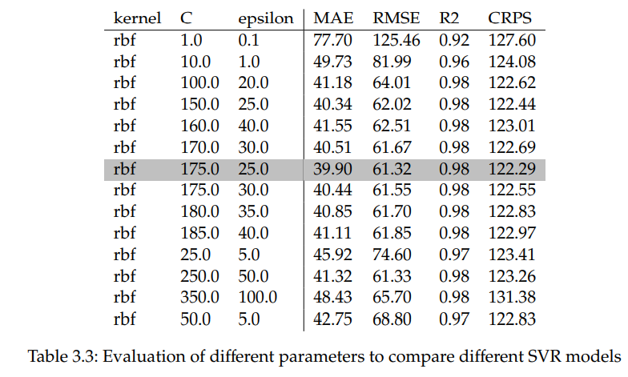
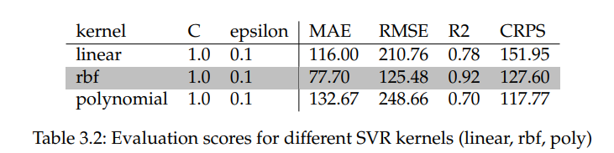
Parameter and Kernel Selection
Figure 7
Figure 6
Notes:
Slide 23
- So we use these features for the Mult Lin Reg model and the SVR model with a 80:20 spilt for training and test data.
- For our SVR model as seen before we can determine the margin for the epsilon tube and the penalty parameter Xi and the kernel
- Here is a selection what I tried and what did look good.
- Same evaluation scores here as well

Slide 24
04 results
Notes:
Slide 24
- finally some results and something maybe more interesting

Slide 25
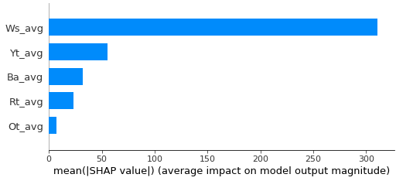
Multiple Linear Regression model
Figure 8
Notes:
Slide 25
the pitch angle (BA)
the hub temperature (Rt)
the nacelle temperature (Yt)
the wind speed (Ws)
the outdoor temperature (Ot)
The Shapley values for our Mult Lin reg model
We can try to explain what frature is more important for our different models
- The wind speed feature is approximately twice as important as every other feature
combined. The outdoor temperature is the least significant value

Slide 26
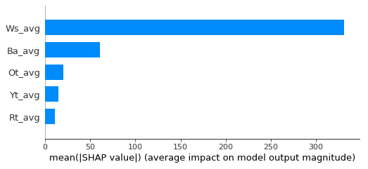
Support Vector Regression model
Figure 9
Notes:
Slide 26
the pitch angle (BA)
the hub temperature (Rt)
the nacelle temperature (Yt)
the wind speed (Ws)
the outdoor temperature (Ot)
- The Shapley values for our SVR
- We notice that not much has changed compared to the Mult Lin Reg model. The wind speed
feature is approximately twice as important as every other feature combined stil.
- The outdoor temperature is more important for the SVR model than the Multiple Linear
Regression model.
- The hub temperature is the least significant here.
- Overall we can see that both models use the same features with kind of the same Shapley Value
distribution. Only the less essential features have changed.

Slide 27
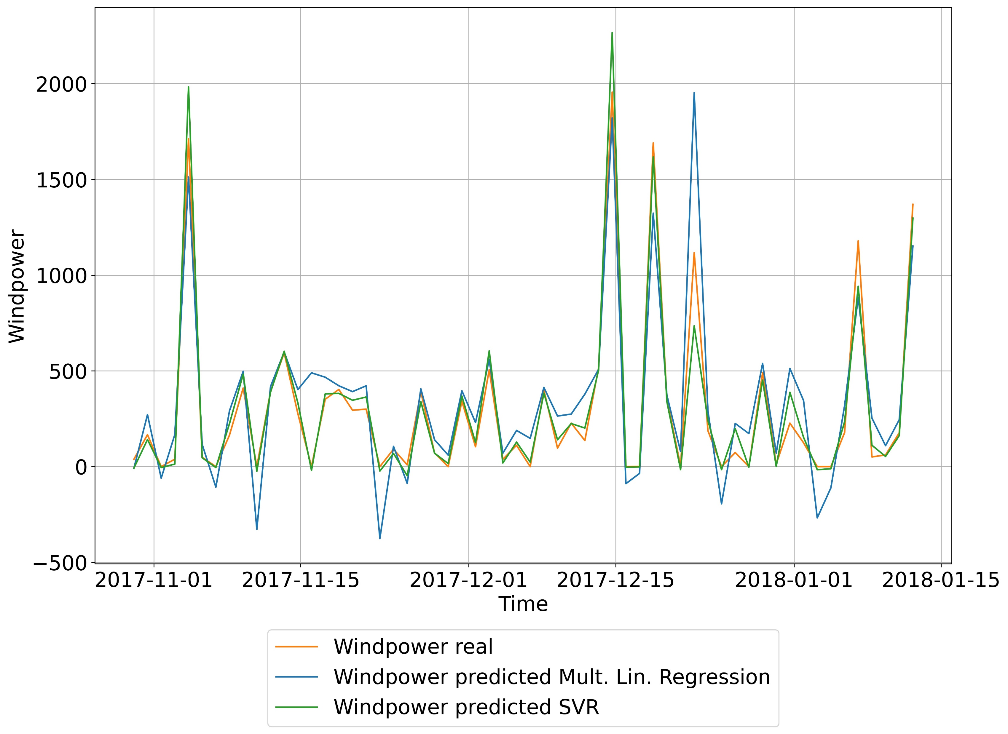
Comparison
Figure 10
Notes:
Slide 27
- as mentioned before used a train test splitof 80:20 so we have the test
dataset and can plot the real data and the predicted data on a timeline.
Real dataset in orange
Blue lines are from the multiple Linear Regression data
Green is the SVR model
- on the left y axis we have Windpower in watt-hour and on the x axis a timeline
The green and the orange functions are more close to each other.
- As we can see some spikes and lows are not quiet reached. A more narrow comparison in the next slides with evaluation values

Slide 28
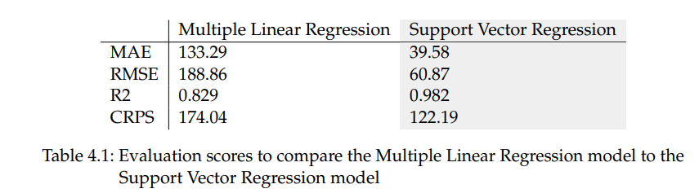
Comparison
Figure 11
Notes:
Slide 28
- finally comparing the both models with pur best selected parameters and features our evaluation scores.
MAE MultLin: 133.29 SVR: 39.58 SVR 3 times closer
RMSE MultLin: 188.86 SVR:60.87 Same as MAE as expected
R2 MultLin: 0.829 SVR:0.982 R2 really good for SVR
CRPS MultLin: 174.04 SVR:122.19 CRPS comparing these values confirms the other evaluations cores

Slide 29
05 Conclusion
Conclusion
Discussion
Notes:
Slide 29
- to come to an conclusion

Slide 30

Conclusion
Main work
data processing
parameter selection
modeling a Multiple Linear Regression model
modeling a Support Vector Regression model
evaluating and comparing the different models
Notes:
Slide 30
- what did the thesis consist of
- data processing
- parameter selection
- modeling a Multiple Linear Regression model
- modeling a Support Vector Regression model
- evaluating and comparing the different models and come to an conclusion

Slide 31
Conclusion
SVR approach works better for this particular wind farm dataset
I assume an SVR approach generally works better for wind power prediction than a Multiple Linear Regression approach
Notes:
Slide 31
-assessed two different machine learning approaches for wind power forecasting.
Multiple Linear Regression model and a Support Vector Regression model.
- Both models can predict wind power reasonably. However, the
SVR model has overall better evaluation scores. The MAE score, the RMSE score,
the R2 score, and CRPS show better results in the SVR model than in the Multiple
Linear Regression model.
- So to finalize the SVR approach works better for this particular wind farm dataset. Furthermore, we suspect an SVR approach
generally works better for wind power prediction than a Multiple Linear Regression approach
- We assume that this is because the Mult Lin Reg only looks at the linear data where SVR can look at many differen feature space and may have other viewpoints to the dataset.

Slide 32

Discussion
Thank you so much for your interest and attention
Any questions?
Notes:
Slide 32
And yeah thats basically it.
Thank you for your interest and attention
Any questions?

